Slide 1
COCOMO- COnstructive COst MOdel

Slide 2
COCOMO-COnstructive COst MOdel
COCOMO proposed by Barry Boehem in 1981.
It is a software cost estimation model used in the field of software engineering
It is used in the software industry as a foundation for software cost estimation.
It is widely used in the software industry as a basis for estimating project costs and resources
It provides only an estimate and should be used as a starting point for project planning.
This model depends on the number of lines of code (LOC) for software product development.
It helps in project planning, resource allocation, and budgeting

Slide 3
In COCOMO, projects are categorized into three types:
Organic
Small team size
Problem solved in past
Nominal experience regarding the problem
Eg: simple business, data processing system, etc.
Semi-detached
a mixture of experienced and inexperienced staff
Lie between organic and embedded
Finite experience in related system
E.g. DBMS management, complexity inventory management, etc.

Slide 4
3. Embeded
Requiring highest level of complexity, creativity and experience
Requires large team size than other model
Developers need to be sufficiently experienced.
E.g.: Banking Software, ATM, etc.

Slide 5
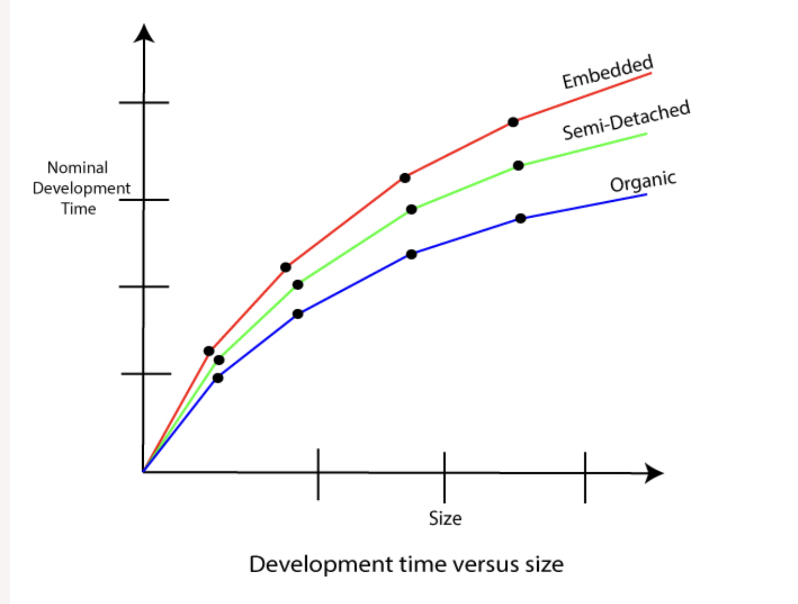
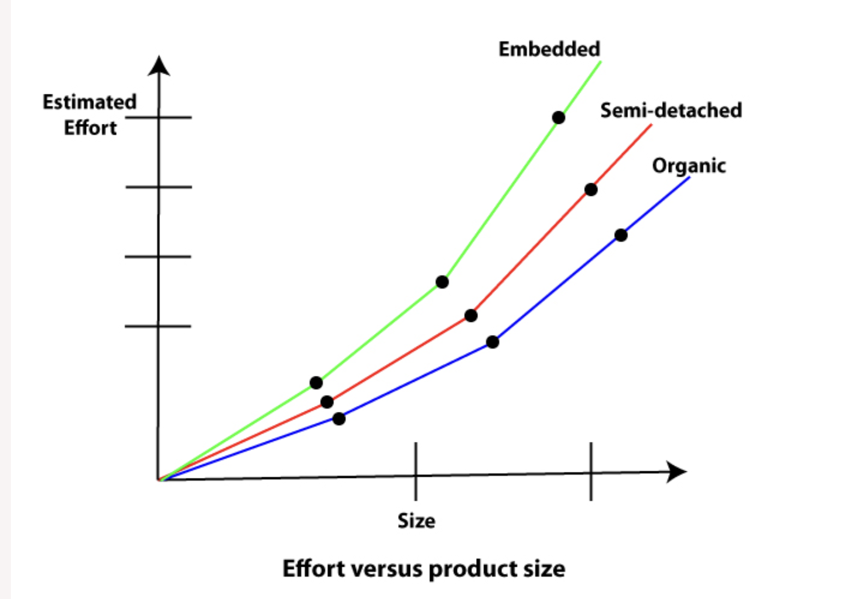

Slide 6
Cocomo Basic Model
Static model to estimates software development effort quickly and roughly.
Deals with number of lines of code.
Level of estimation accuracy is less.
Effort (E) = a*(KLOC)^{b} MM Scheduled Time (D) = c*(E)^{d} Months(M)
Where,
E = Total effort required for the project in Man-Months (MM).
D = Total time required for project development in Months (M).
KLOC = the size of the code for the project in Kilo lines of code.
a, b, c, d = The constant parameters for a software project.

Slide 7
The intermediate cocomo
builds upon the Basic model by incorporating additional cost
estimates software development effort in terms of size of the program
Cost drivers are categorized into various groups:
Product Factors
Platform Factors
Personnel Factors
Project Factors
The estimated effort and scheduled time are given by the relationship:
Effort (E) = a*(KLOC)^{b} *EAF MM Scheduled Time (D) = c*(E)^{d} Months(M)
EAF = It is an Effort Adjustment Factor

Slide 8
The cocomo advanced model
It incorporates all qualities of the standard version with an assessment of the cost drivers
It includes a more comprehensive set of cost drivers to estimate the effort, schedule, and cost
It is for larger and more complex projects.
It help in providing a more accurate estimate for larger projects with diverse characteristics.
The Six phases of detailed COCOMO are:
Planning and requirements
System structure
Complete structure
Module code and test
Integration and test
Cost Constructive model

Slide 9
Advantages
Easy to estimate the total cost of the project.
Benchmarking and comparisons
Communication and stakeholder management:
Easy to implement with various factors.
Provide ideas about historical projects.
Disadvantages
It ignores requirements, customer skills, and hardware issues.
Lack of flexibility
Dependency on historical data
It limits the accuracy of the software costs.
It mostly depends on time factors.

Slide 10
Thank you

